Slide 1
Environment Setup
Visual Studio 2022 and SQL Server

Slide 2
Download links
Downloading Visual Studio Community Edition (microsoft.com)
SQL Server Downloads | Microsoft
Links may change in the future, please refer to the Microsoft website for latest version of Visual Studio, SSMS and SQL Server.

Slide 3
Installing Visual Studio 2022

Slide 4
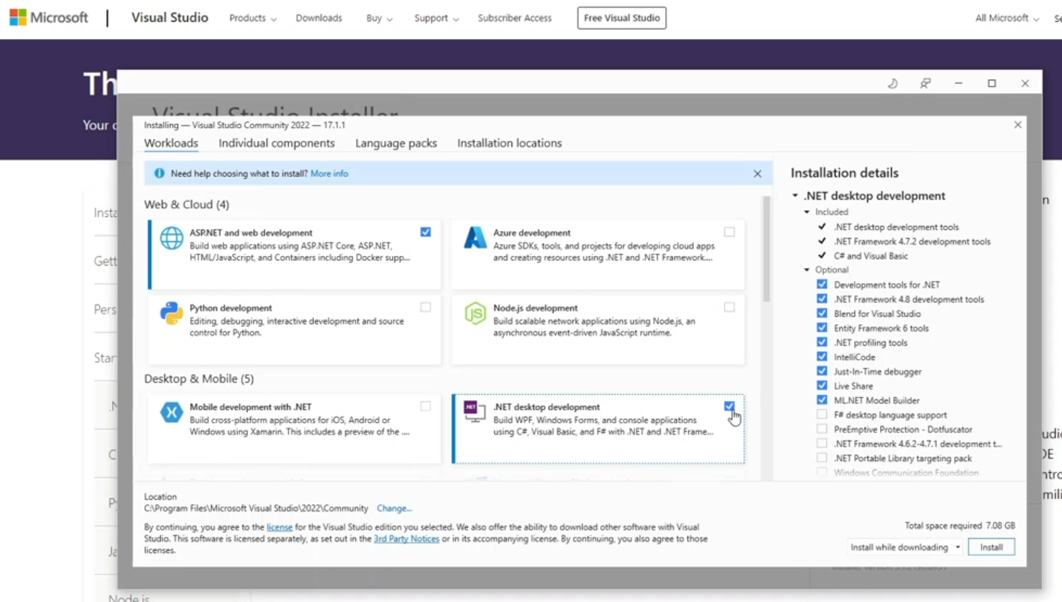

Slide 5
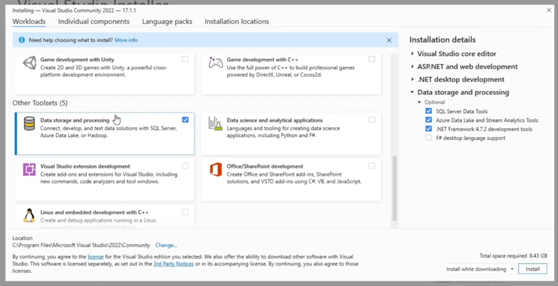

Slide 6
Installing SQL Server Developer Edition

Slide 7
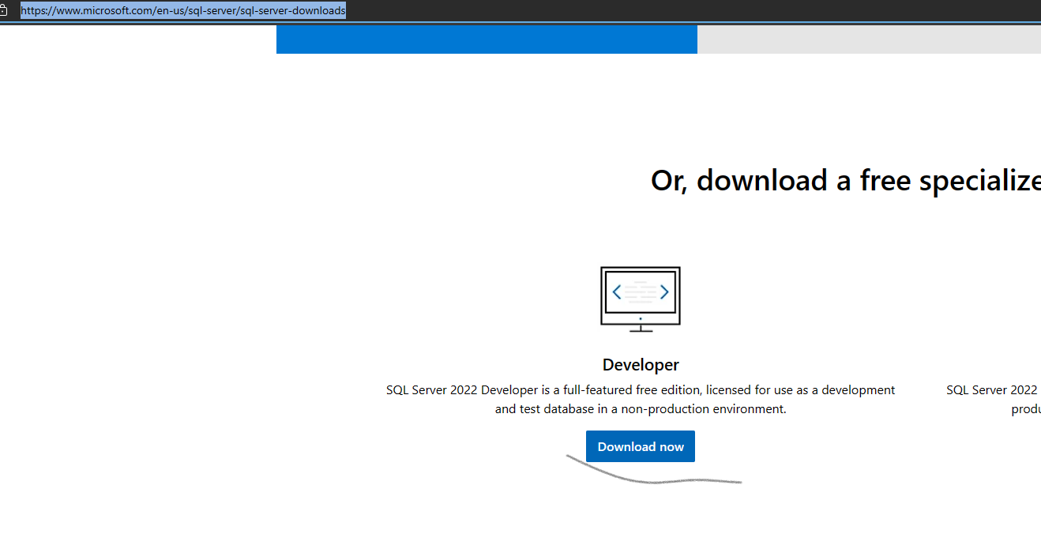

Slide 8
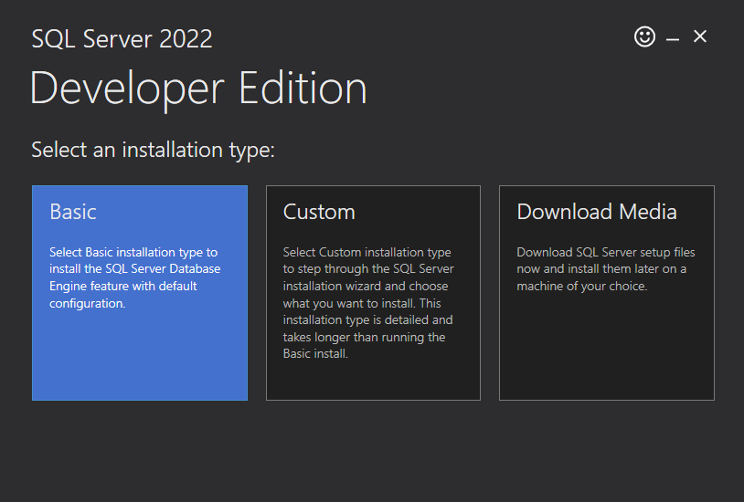

Slide 9
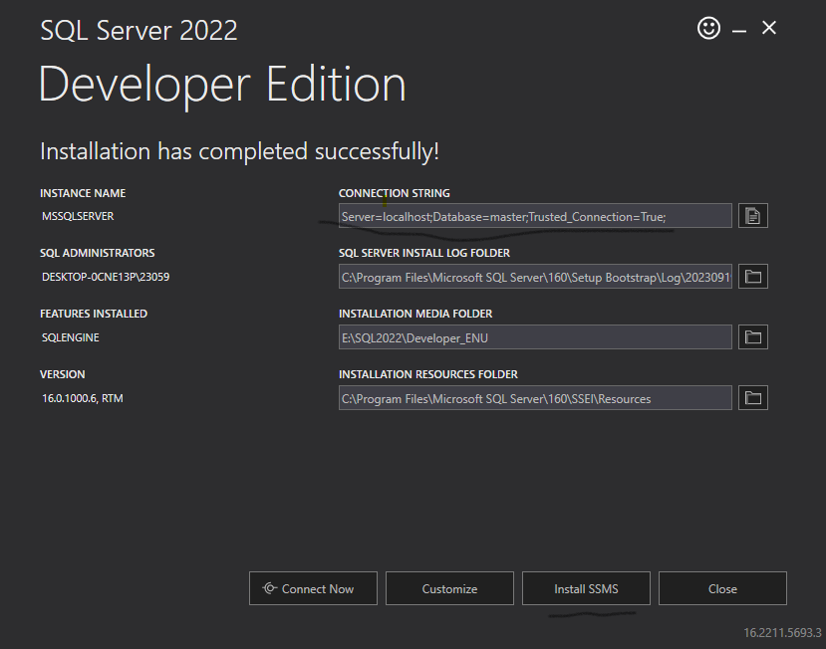

Slide 10
